Slide 1
System Settings Note: Permissions are required for complete access to all of the features described herein.
February, 2013

Slide 2
System Settings
Use the System Settings feature (Administration → Application → System Settings) to manage settings that are used by the various Emptoris Contract Management features throughout the lifecycle of a contract.
System Settings takes you to a page with four tabs:
System Settings: There are numerous values that control how Emptoris behaves for one particular organization and its children. Organizations that do not have settings defined use the settings of the nearest parent that does.
Process Schedules, Jobs List, Job Control: These are used to schedule and control batch processes for all organizations in the Emptoris system.

Slide 3
System Settings, cont.
The System Settings tab has these sub-tabs, all of which provide organization-level settings:
Negotiation: Controls features related to the presentation and execution of contracts, and whether restrictions are applied to the editing of contract language in emailed or checked out contracts
Language: Allows you to upload a format template for contracts, and controls whether users can edit contracts or clauses during approvals.
New in V10.0.1: can configure whether the Language tab and Word Editor display Clause Titles (default) or Clause Names in the Table of Contents (but can be overridden by user)
Events: Lets you change the notification defaults for new contract event definitions, and the “From” email address to be shown in notifications.
Renewals: Controls settings related to the Quote Generation and Renewal Notifications features
Workflow: Controls settings for work days and delegation of permissions along with tasks

Slide 4
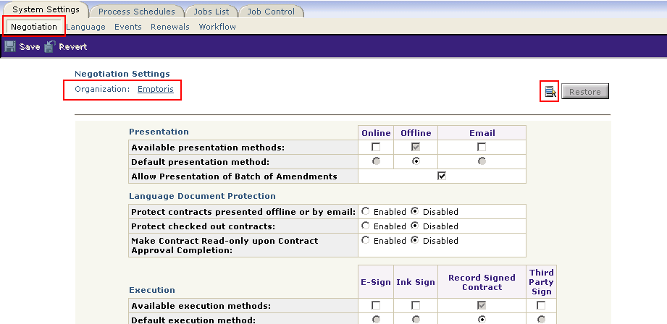
System Settings, cont.
Sample of System Settings (Negotiation settings). This is for a particular Organization, but a different organization can be chosen via the selector on the right.

Slide 5
Process Schedules
You can use the Process Schedules feature to schedule and enable or disable the following batch processes:
Issue Contract event notifications and close completed events
Contract Status updates to Active, Terminated, and Expired
Generate renewal quote contracts and issue related notifications
Issue notifications as defined through Notification Rules
Task Delegation
Export contract data to CSV (for use with Spend Analysis)
Update indexes for keyword searches of Contracts and Clause/Contract/Notification templates,
Clean up old jobs from the database (those with time older than configured value)
Delete contracts: purge the database of contracts that have reached their Deletion Date
Typically, these processes are run at night to avoid overloading the system during working hours. These processes can also be run immediately by using the “Run Now” buttons.
Note: The scheduling of these batch processes is based on the host server time zone, not the user time zone. Therefore, times may be set in a different time zone than your own and may include or exclude Daylight Savings.

Slide 6
Questions?

